Slide 1
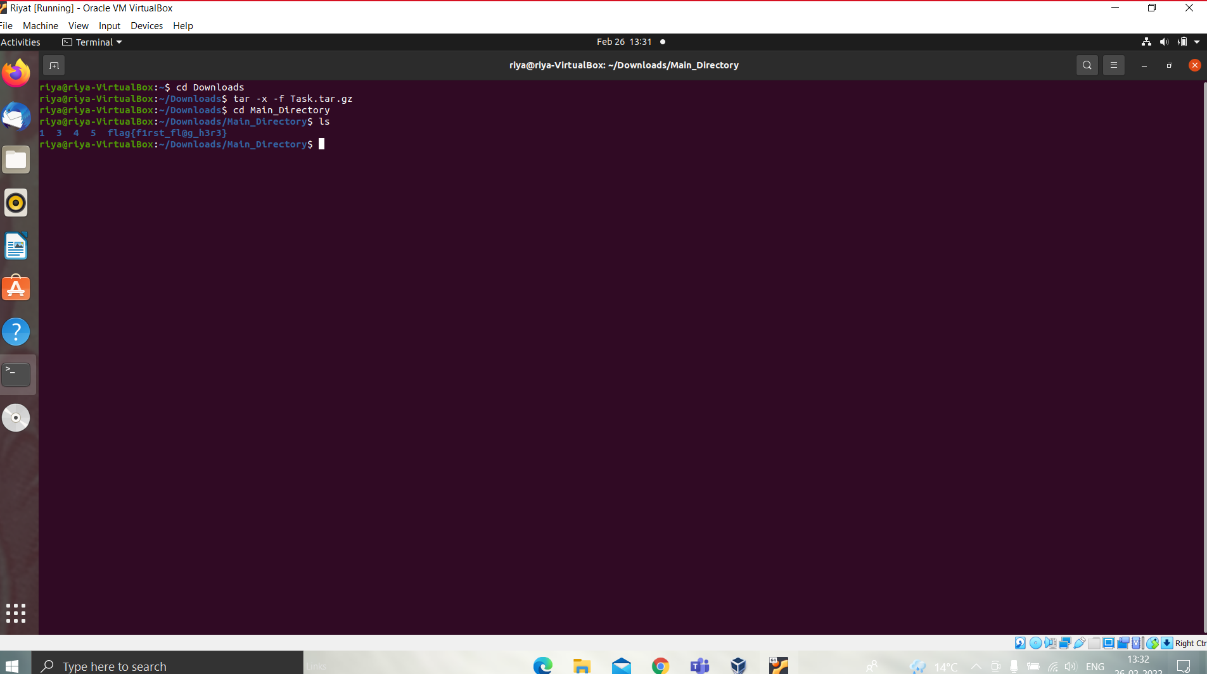
First Flag: flag{first_fl@g_h3r3}

Slide 2
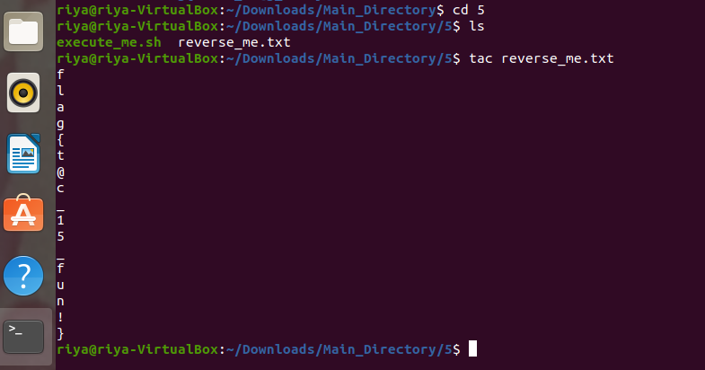
Second Flag: flag{t@c_15_fun!}

Slide 3
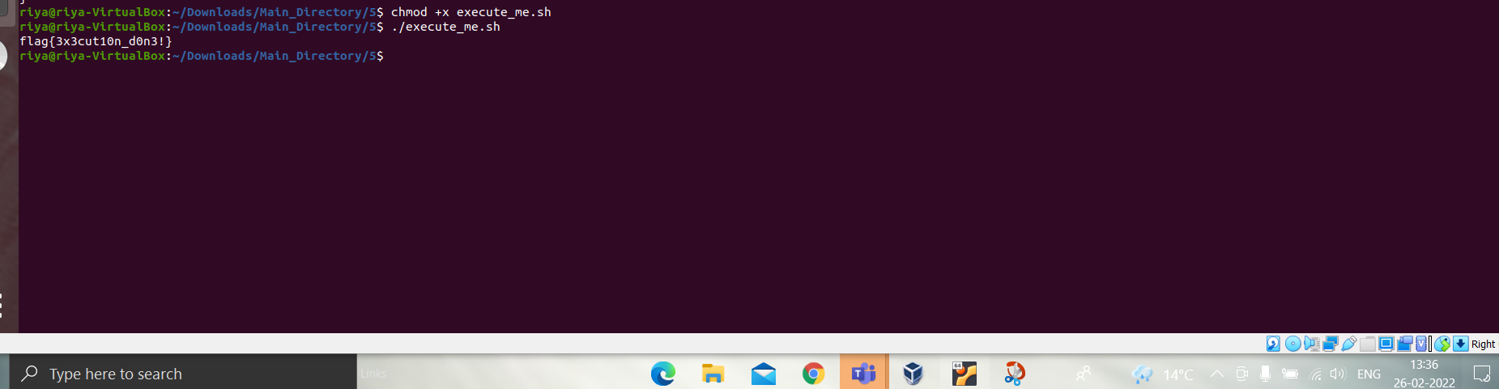
Third Flag: flag{3x3cut10n_d0n3!}

Slide 4
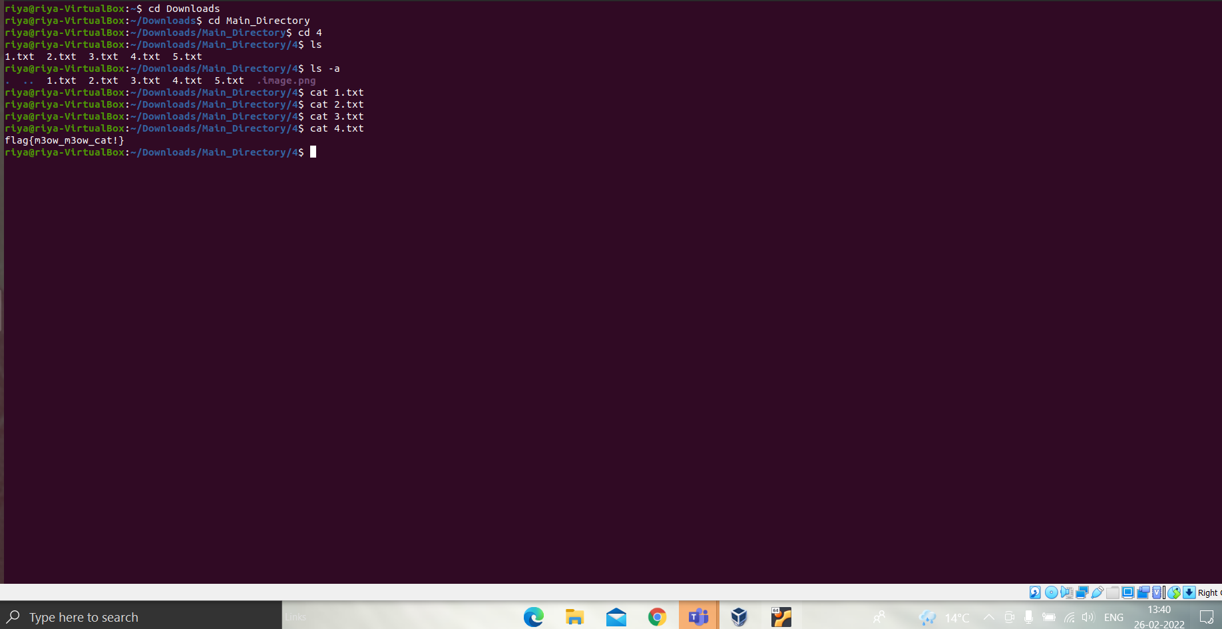
Fourth Flag: flag{m3ow_m3ow_cat!}

Slide 5
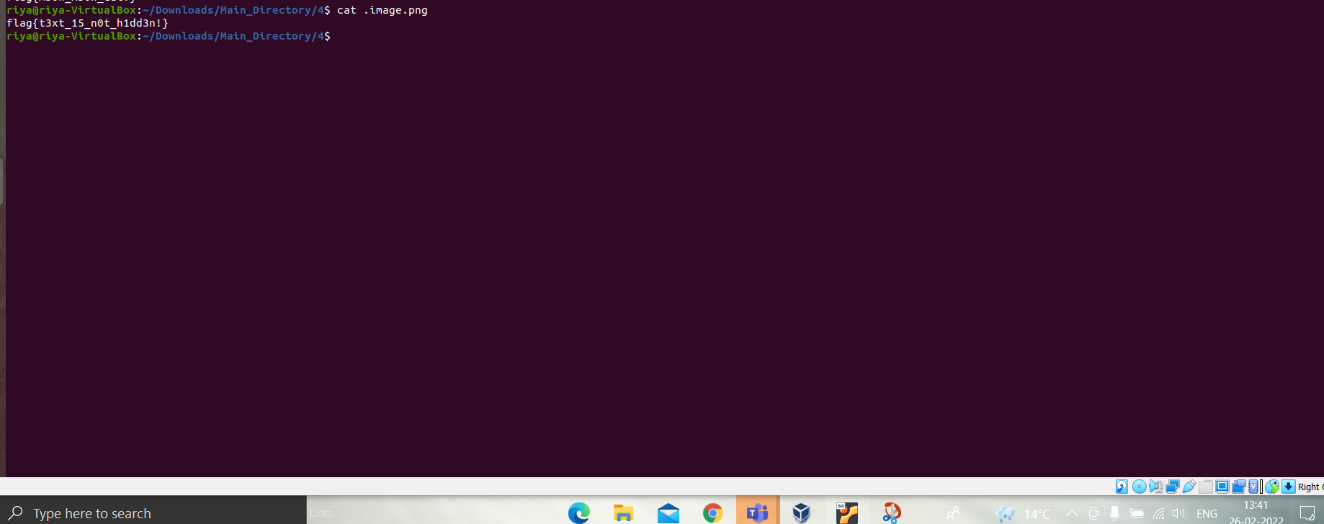
Fifth Flag: flag{t3xt_15_n0t_h1dd3n!}

Slide 6
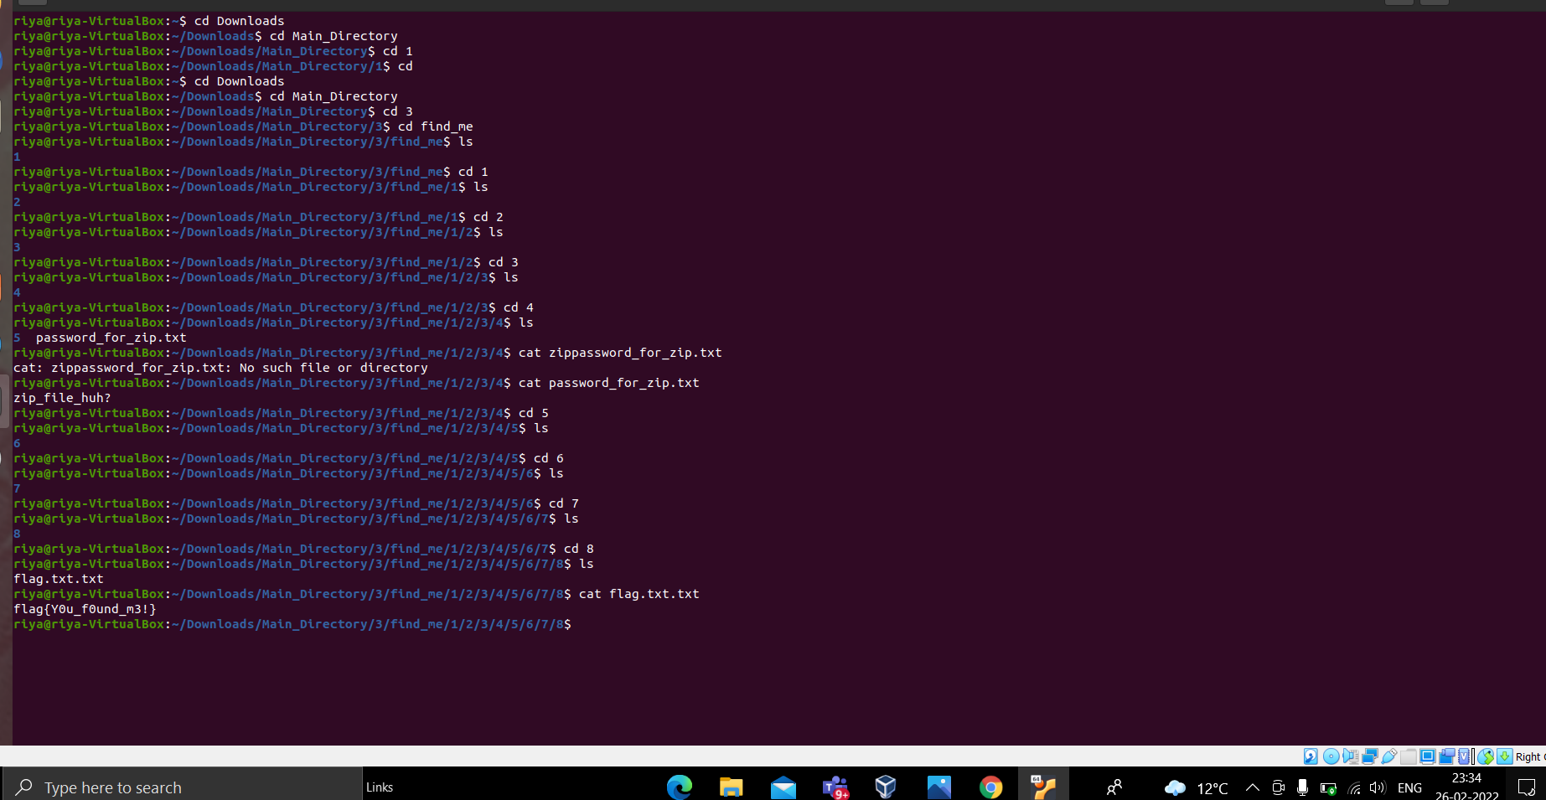
Sixth Flag: flag{Y0u_f0und_m3!}

Slide 7
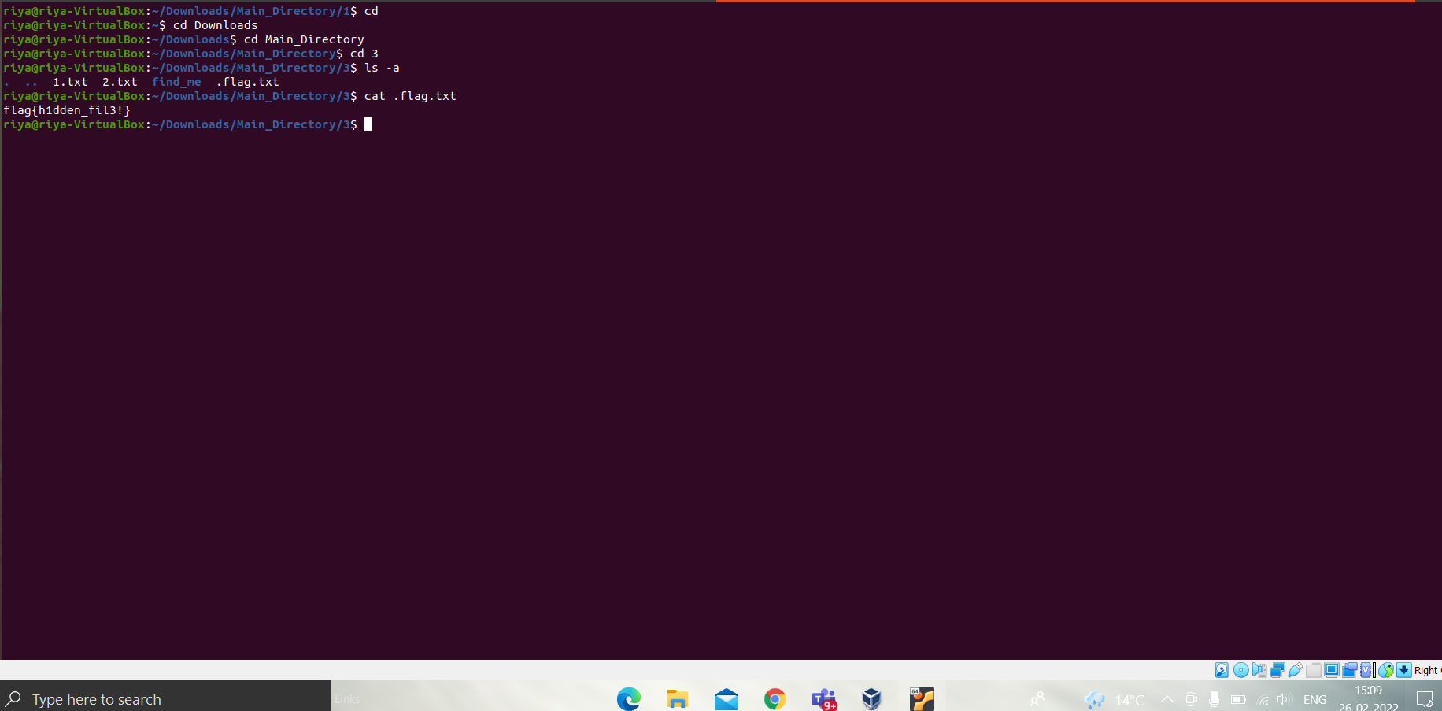
Seventh Flag: flag{h1dden_fil3!}

Slide 8
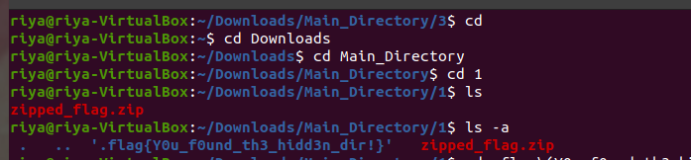
Eighth Flag: flag{Y0u_f0und_th3_h1dd3n_dir!}

Slide 9
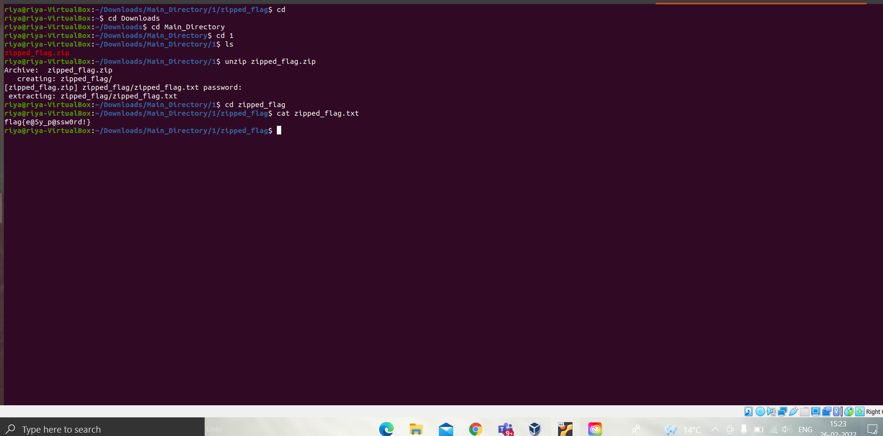
Nine Flag: flag{e@5y_p@ssw0rd!}

Slide 10
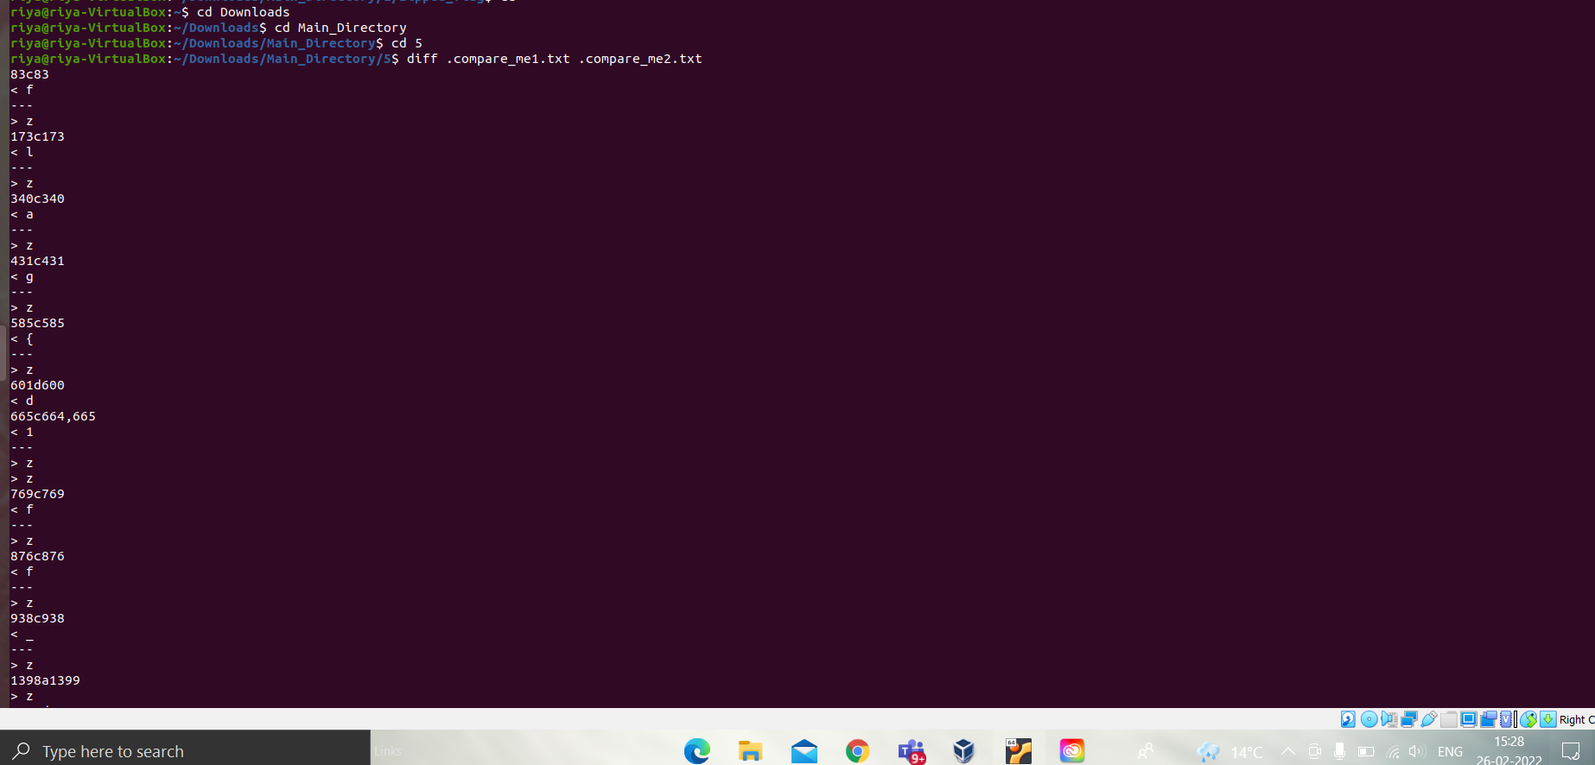
Tenth Flag: flag{diff_15_u53ful!}

Slide 11
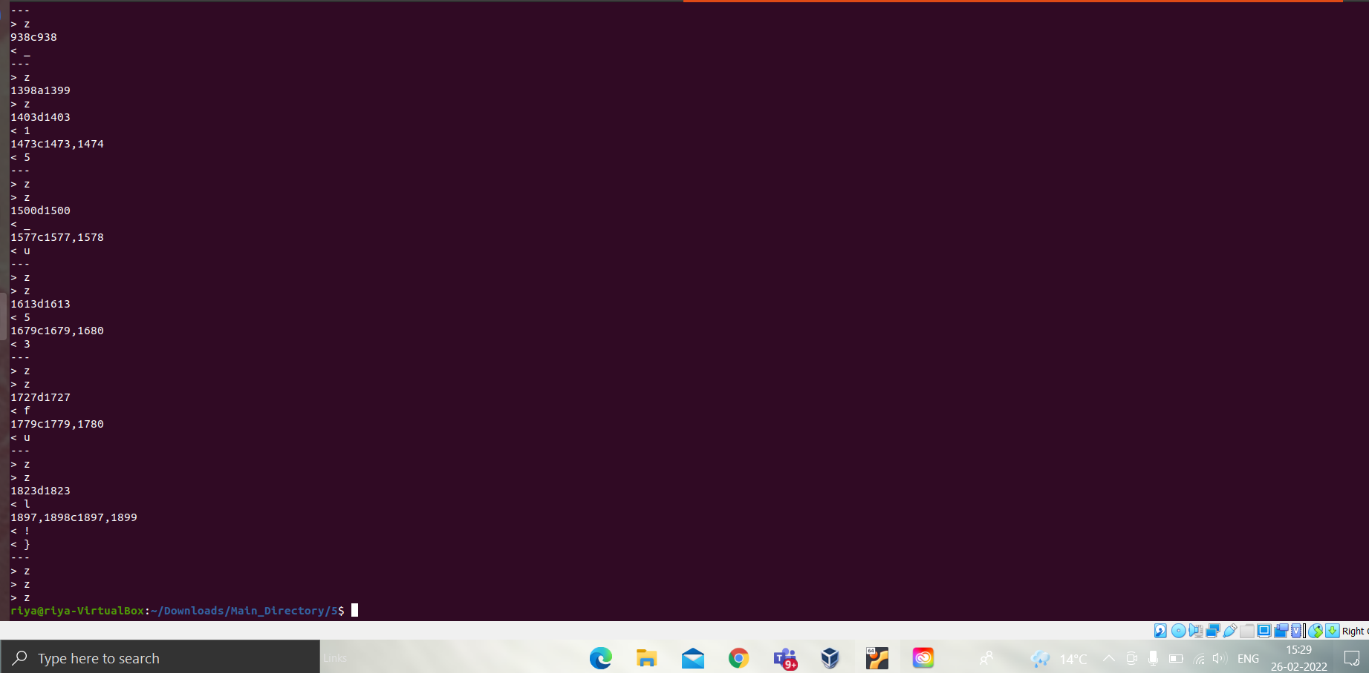

Slide 12
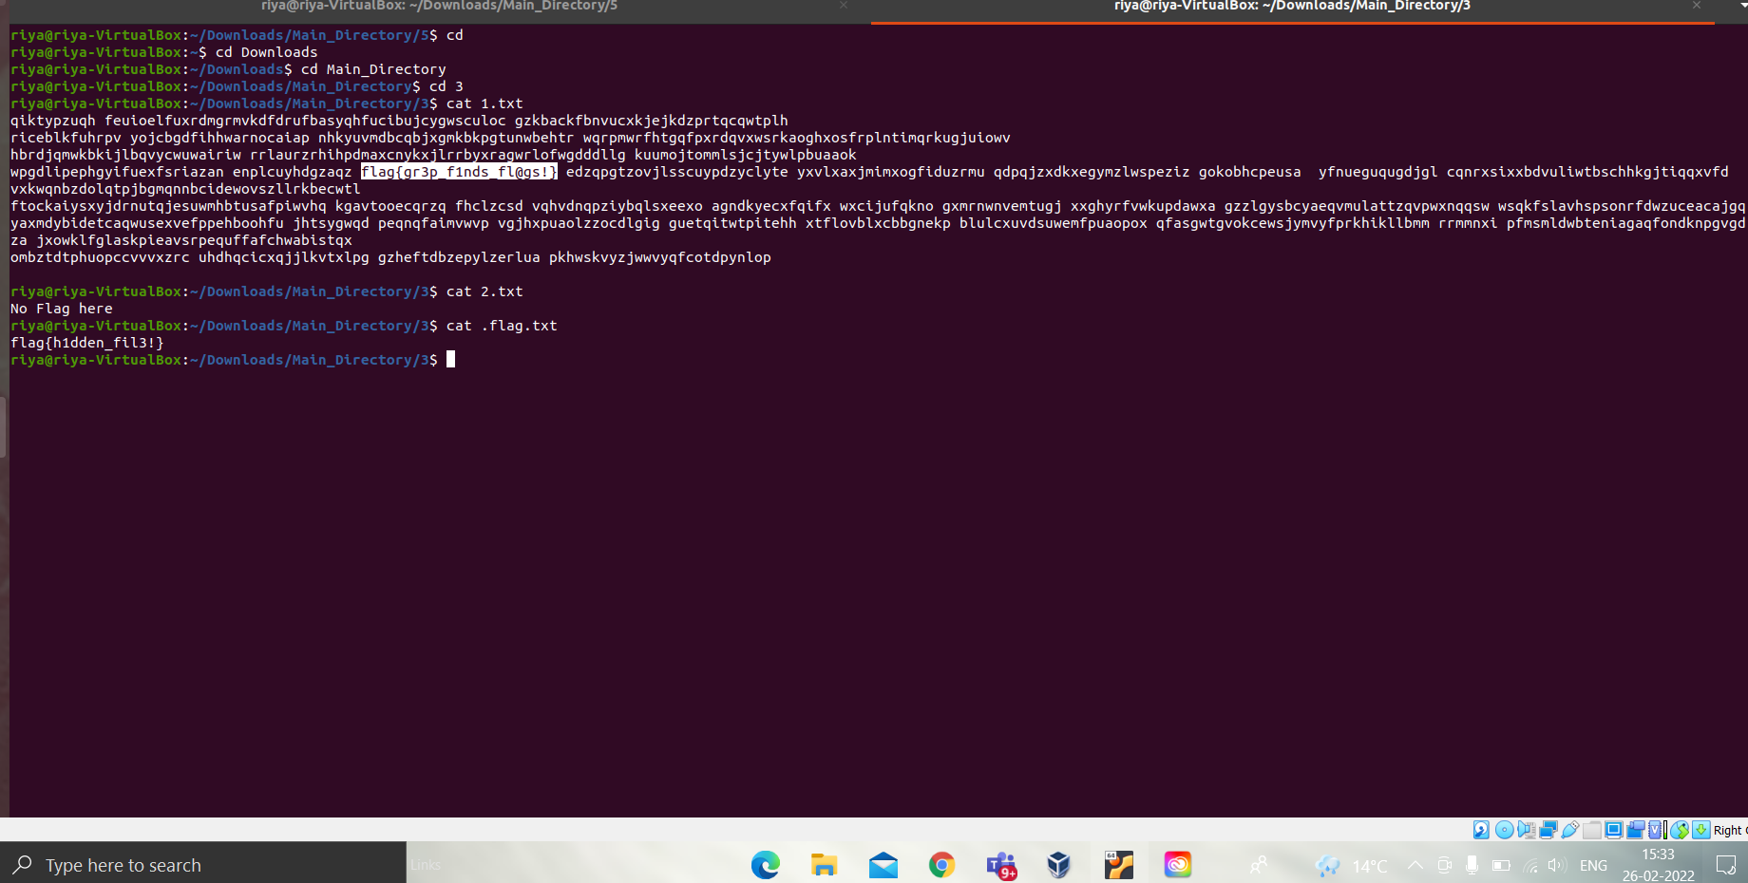
Eleventh Flag: flag{gr3p_f1nds_fl@gs!}

Slide 13
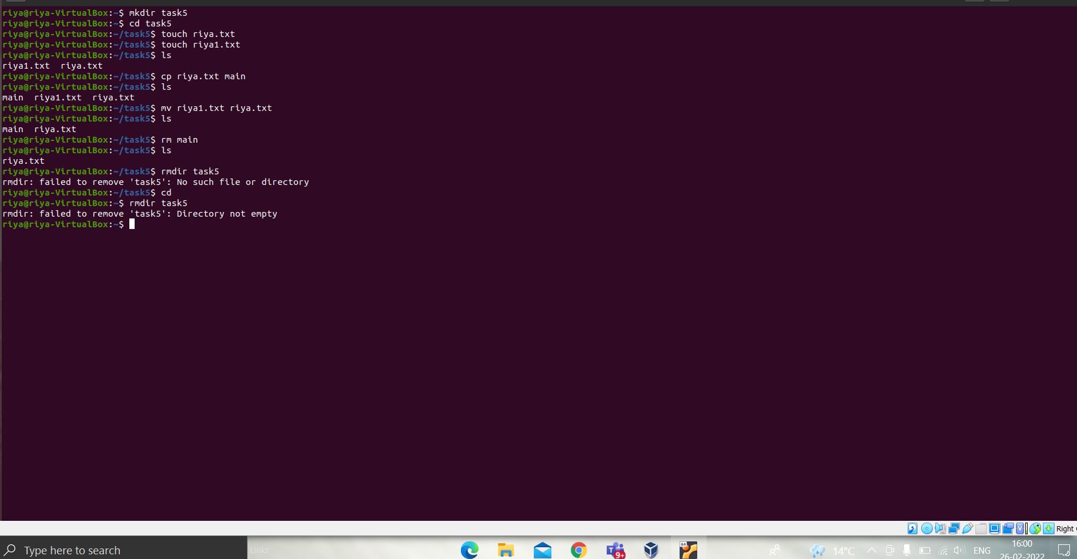
mkdir: New Directory
cp: Copy file

Slide 14
mv: Move file
rm: Remove file

